Slide 1
HEAT CAPACITY

Slide 3
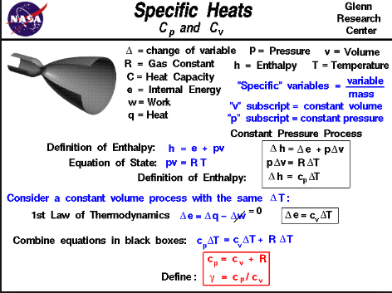

Slide 4
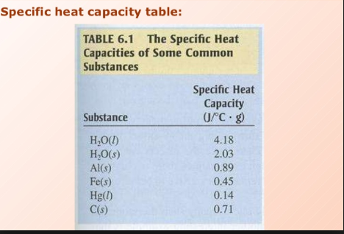

Slide 5
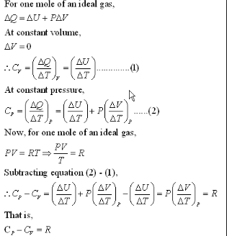

Slide 6
MEASUREMENT OF ∆U AND ∆H
CALORIMETRY

Slide 7
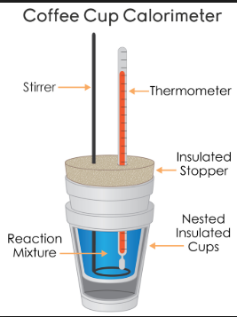

Slide 8
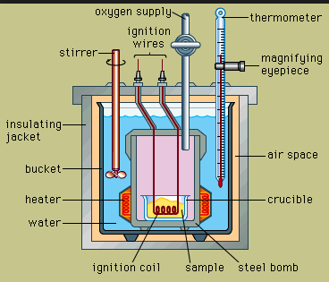
BOMB CALORIMETER

